Slide 1
Manifold Learning For Feature Extraction
Pallab Sarkar
Advanced M/S 4th Year –BEE JU , 8th Sem

Slide 2
Smart
Preface
Introduction
Non Linear Graph Embedding
Todays Topics
Derivation of t-SNE
Coherent Problems Example
New Direction of Manofiold Learining
Metrics & Performance Analysis

Slide 3
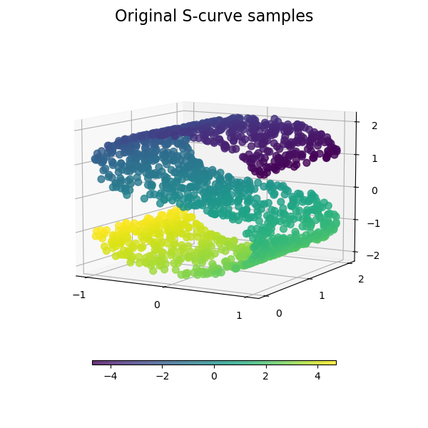
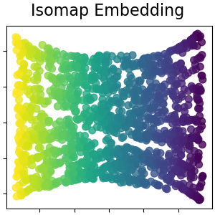
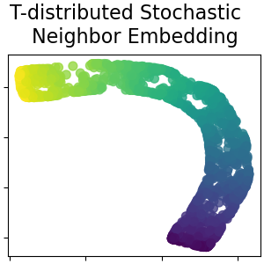
Manifold

Slide 5
Manifold Learning Introduction
Manifold learning is an approach to non-linear dimensionality reduction. Algorithms for this task are based on the idea that the dimensionality of many data sets is only artificially high.
Manifold learning has grown rapidly in the analysis of hyperspectral imagery. High spectral resolution and continuous bands of HSI data enable discrimination between similar targets of interest.
Nonlinearities are often exhibited in the data due to the effects of multipath scattering, variations in Sensor geometry, nonhomogeneous composition of pixels, and attenuating properties of media.
Feature selection and extraction approaches for dimensionality reduction have received significant attention.
The potential value of manifold-based approaches for HSI analysis has been demonstrated for various applications.

Slide 6
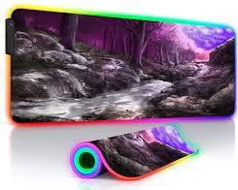
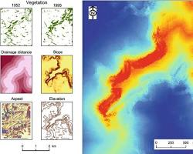
RGB Image: Imagine a typical photo of a forest taken with your phone. It would capture the vibrant greens of the leaves, the browns of the tree trunks, and the blue of the sky in broad strokes
HSI Image: Now, picture the same forest scene, but instead of the broad color bands, you have hundreds of narrow, precise spectral bands capturing the unique "fingerprints" of each element. This could reveal subtle variations in plant health, mineral composition, or even air quality.

Slide 7
Nonlinear Manifold Learning- Graph embedding framework
Nonlinear dimenormalization reduction algorithms can be adapted to a graph embedding frame to measure the distance between two sample observations.
The affinity functions do not use class label information but rather characterize the neighborhood relationships between pairs of points based on feature differences.
A popular approach to measure affinity between samples xi and xj makes use of the heat-kernel.
Further improvements can be achieved by adapting the scaling parameter chi2 to the local data statistics.
Separate affinity matrices dedicated to each source can be used to address disparity in the resulting feature spaces. A simple approach for geospatial image analysis utilizes composite kernels.

Slide 8
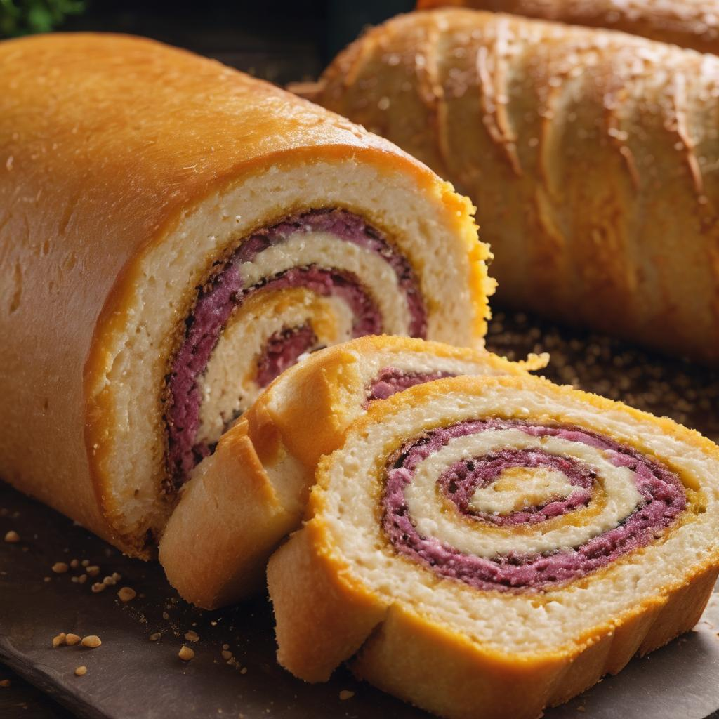
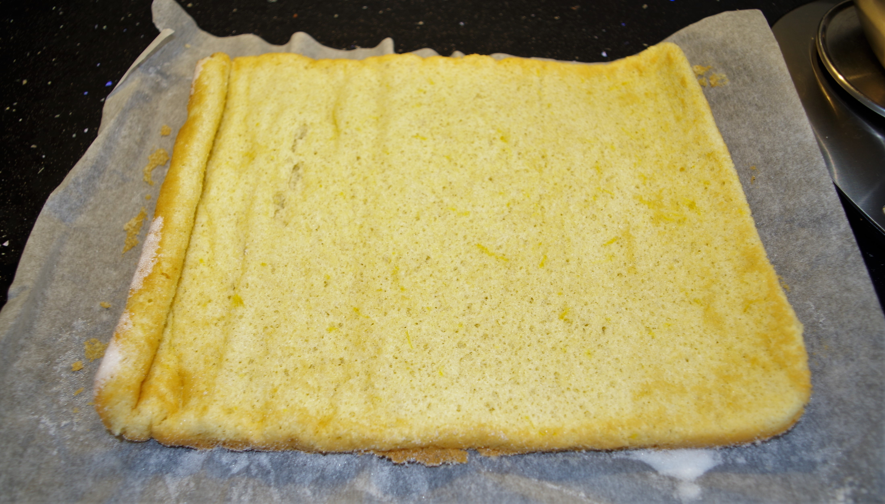
Nonlinear Dimensionality Reduction (NLDR): Techniques for transforming high-dimensional data into a lower-dimensional representation while preserving essential structure and relationships.
Some NLDR Techniques are :
Isomap , t-SNE etc.
Graph Embedding: A framework for representing data as a graph, where nodes represent data points and edges represent relationships between them.
Affinity Functions: Measures of similarity or distance between data points, used to construct the graph in graph embedding.
Swiss Roll:
Imagine: A long, thin sheet of dough rolled up like a cinnamon roll, forming a spiral shape with many twists and turns.
Visualize: NLDR algorithms "unroll" this swiss roll, flattening it onto a 2D plane while preserving the relationships between points.

Slide 9
Heat Kernel: A popular affinity function that measures similarity based on the Euclidean distance between points, with a scaling parameter to control the "smoothness" of the similarity scores.
Local Data Statistics: Incorporating local data characteristics (e.g., density, variance) can improve affinity measures.
Multiple Sources and Disparity- ANCHOR BOXING: When combining data from multiple sources, separate affinity matrices can handle differences in feature spaces.
Composite Kernels: Combining multiple kernels (e.g., heat kernel, spatial kernel) can enhance analysis, especially for geospatial imagery.

Slide 10
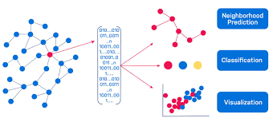
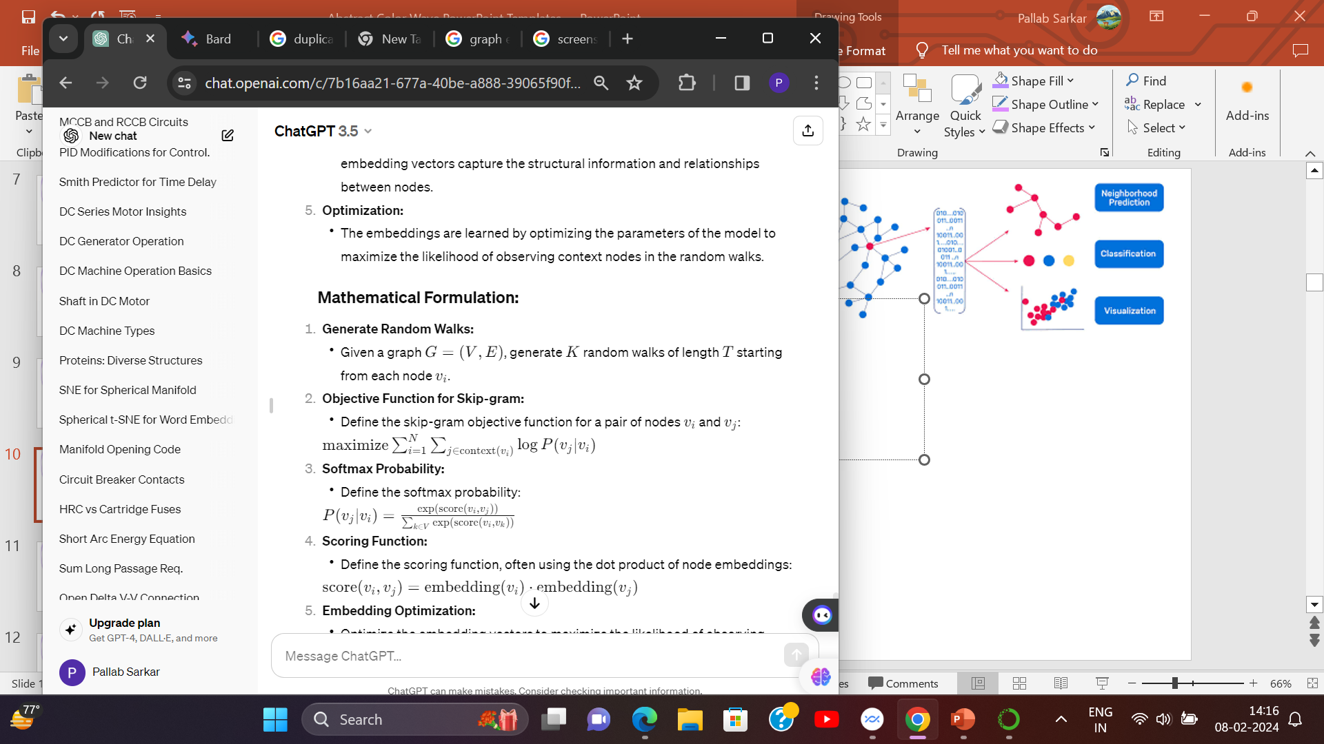
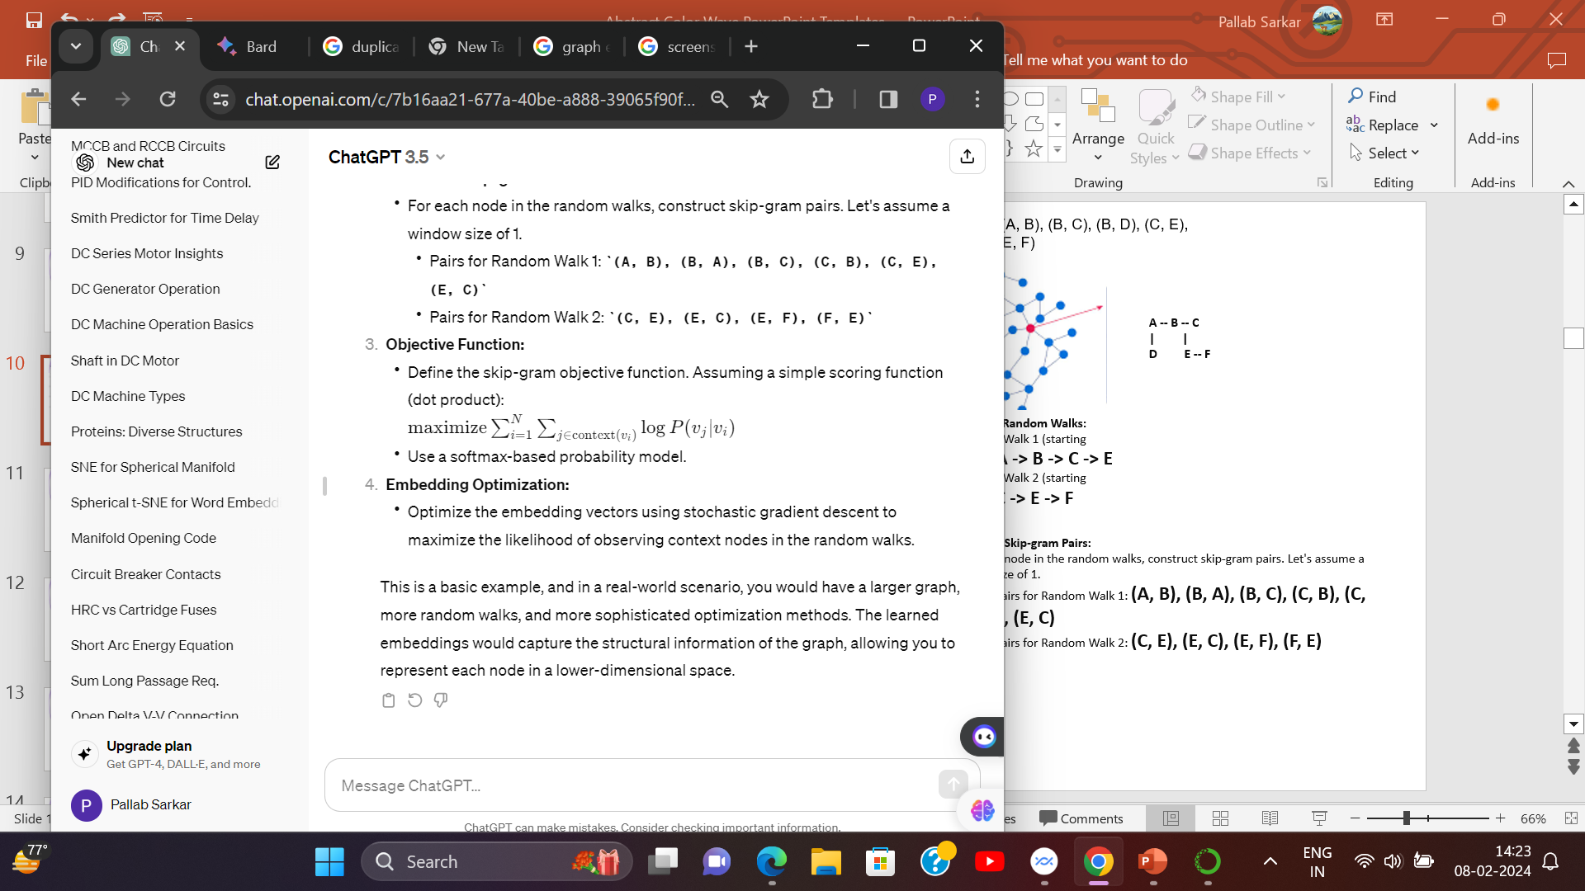
Edges: (A, B), (B, C), (A, C), (B, E), (D, A), (E, F)
Graph embedding framework:-
A --- B -- C
| |
D E -- F
G
Generate Random Walks:
Random Walk 1 (starting from A): A -> B -> E -> F
Random Walk 2 (starting from C): C ->B-> E -> F
Construct Skip-gram Pairs:
For each node in the random walks, construct skip-gram pairs. Let's assume a window size of 1.
Pairs for Random Walk 1: (A, B), (B, A), (B, E), (E, B), (E, F), (F, E)
Pairs for Random Walk 2: (C, B), (B, C), (B, E), (E, B),(E,F),(F,E)
Graph Embedding: A framework for representing data as a graph, where nodes represent data points and edges represent relationships between them.

Slide 11
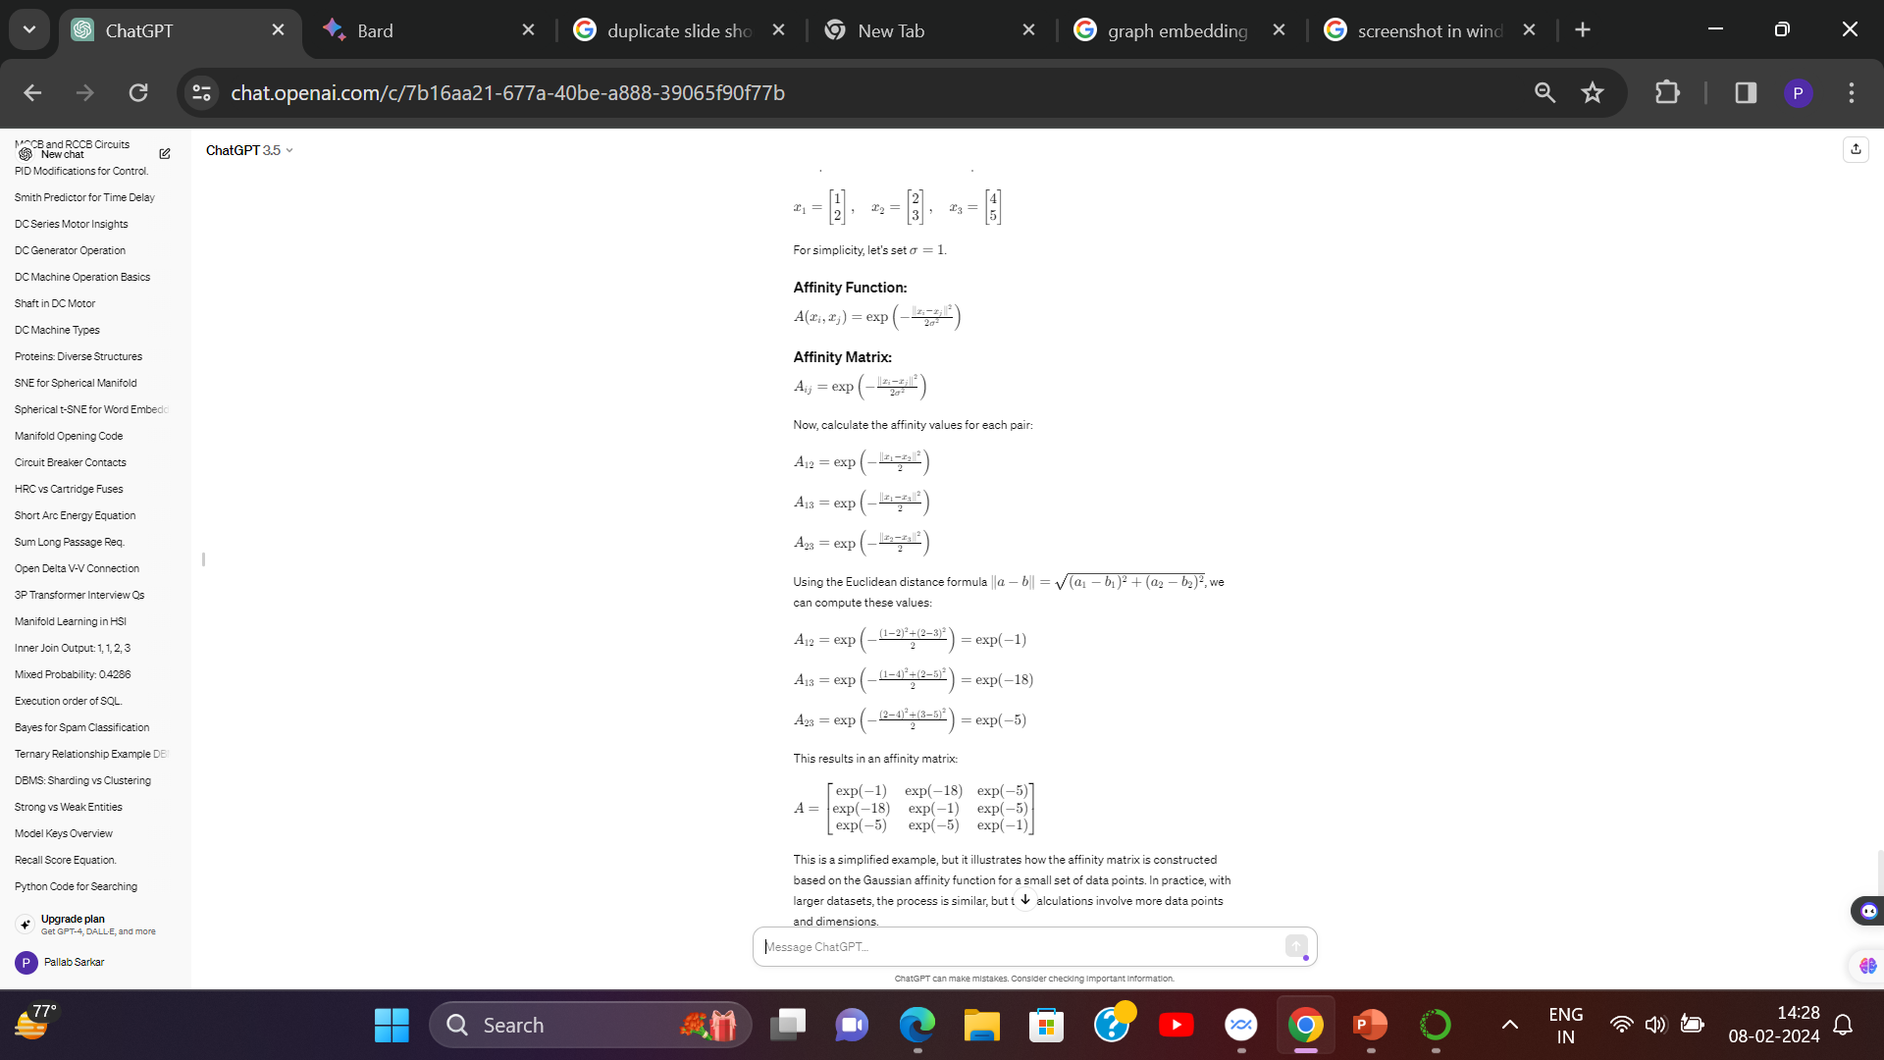
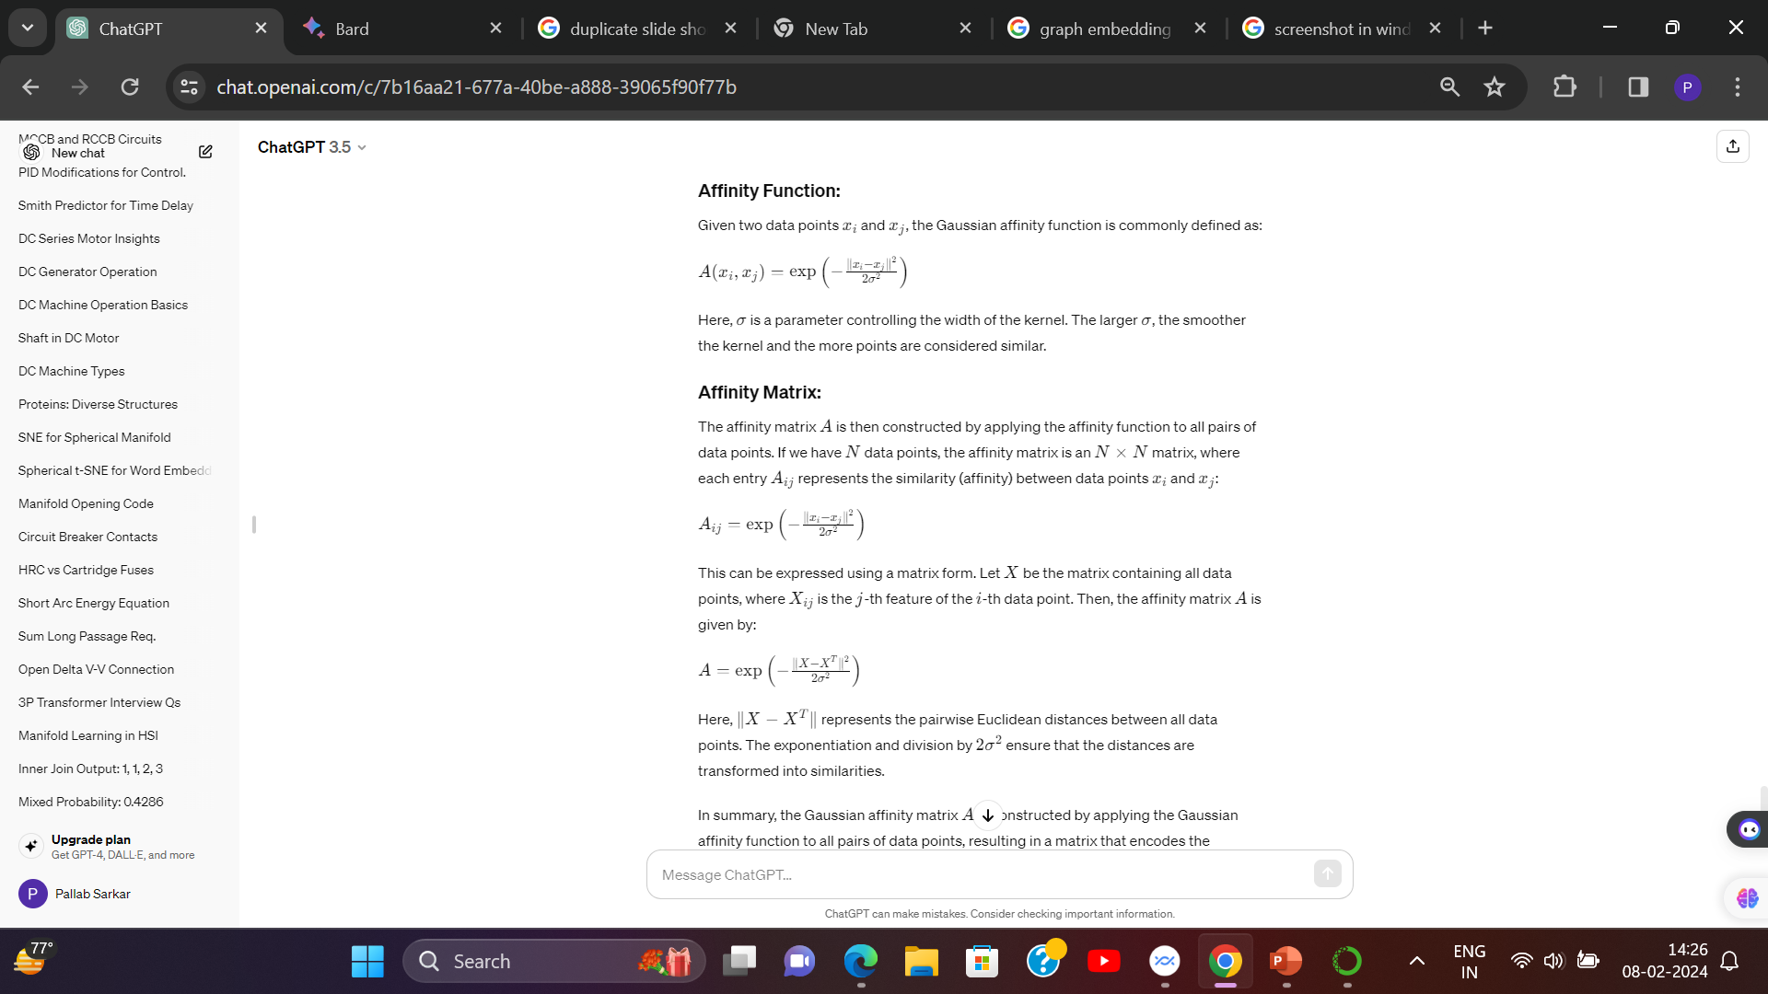
Affinity Function & Affinity Matrix:-
Affinity Functions: Measures of similarity or distance between data points, used to construct the graph in graph embedding.

Slide 12
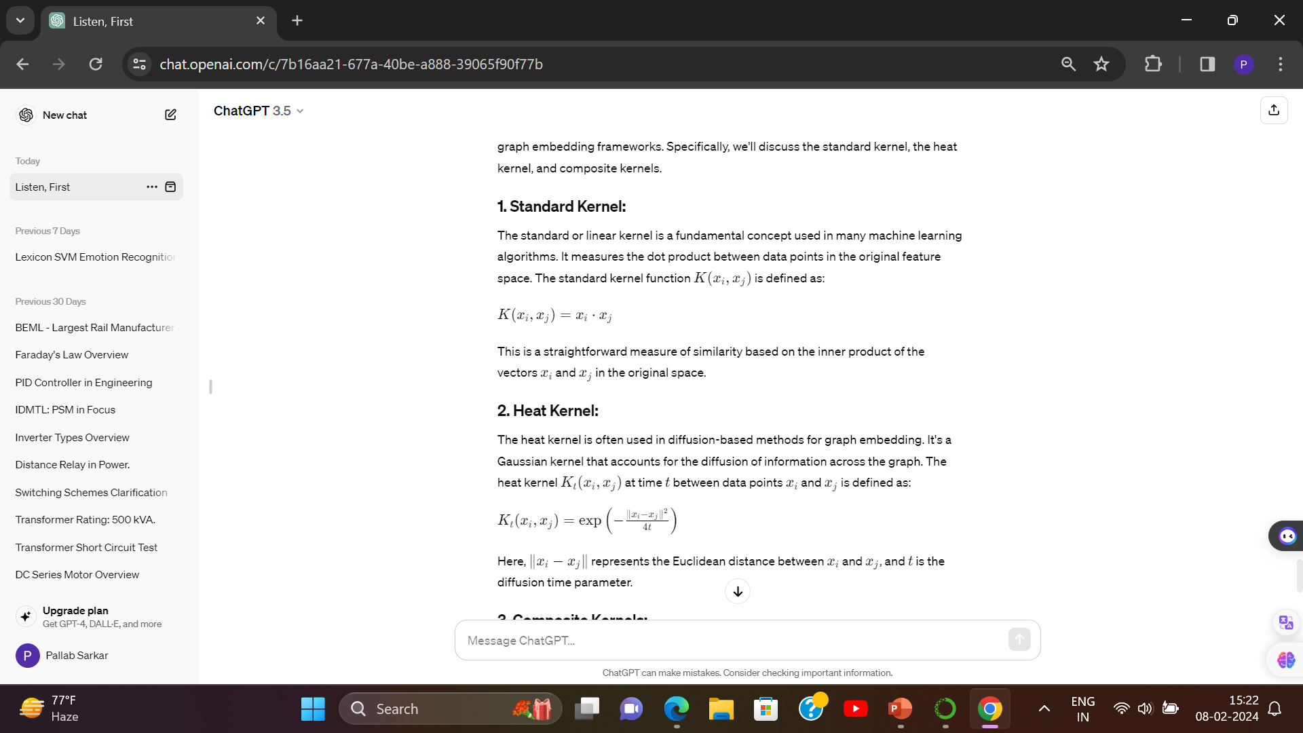
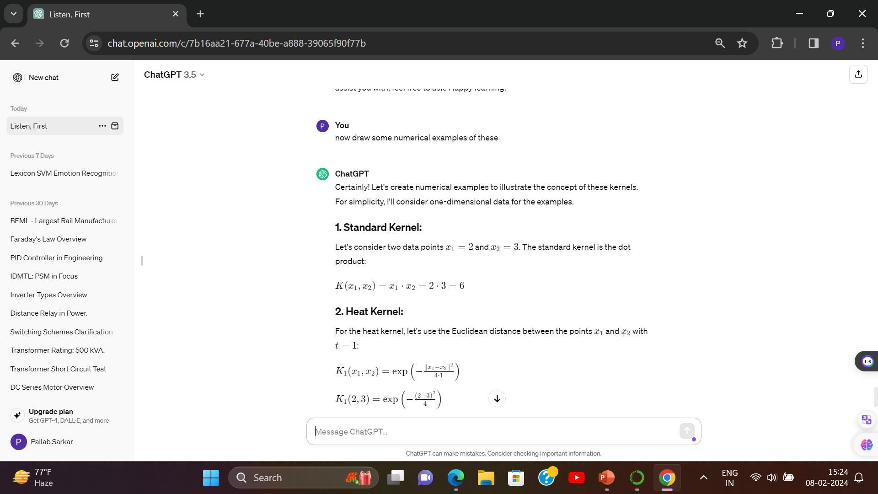



Kernels
Kernels are advancement over Affinity Function to perform smoothness for more better graph embedding.

Slide 13
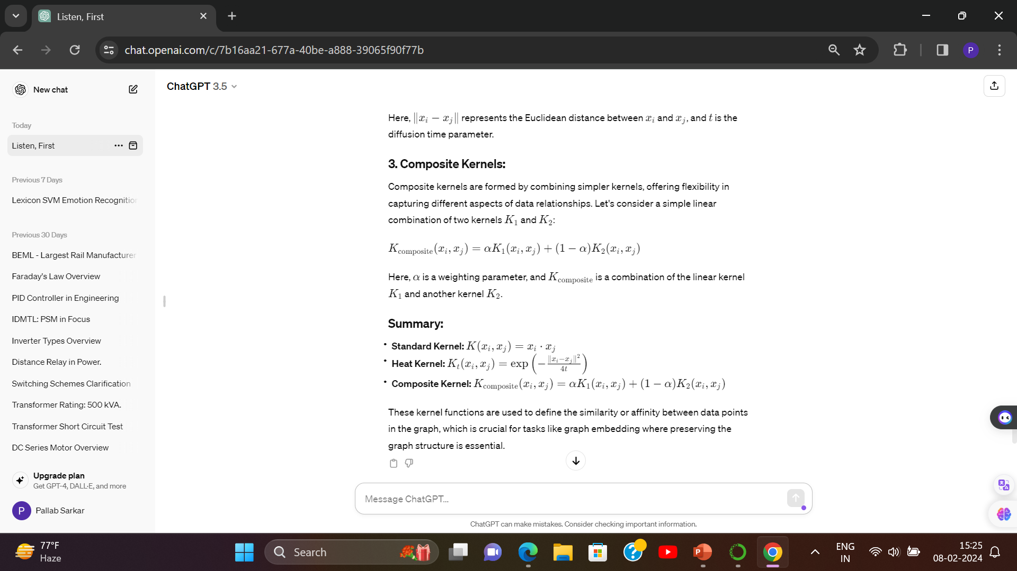
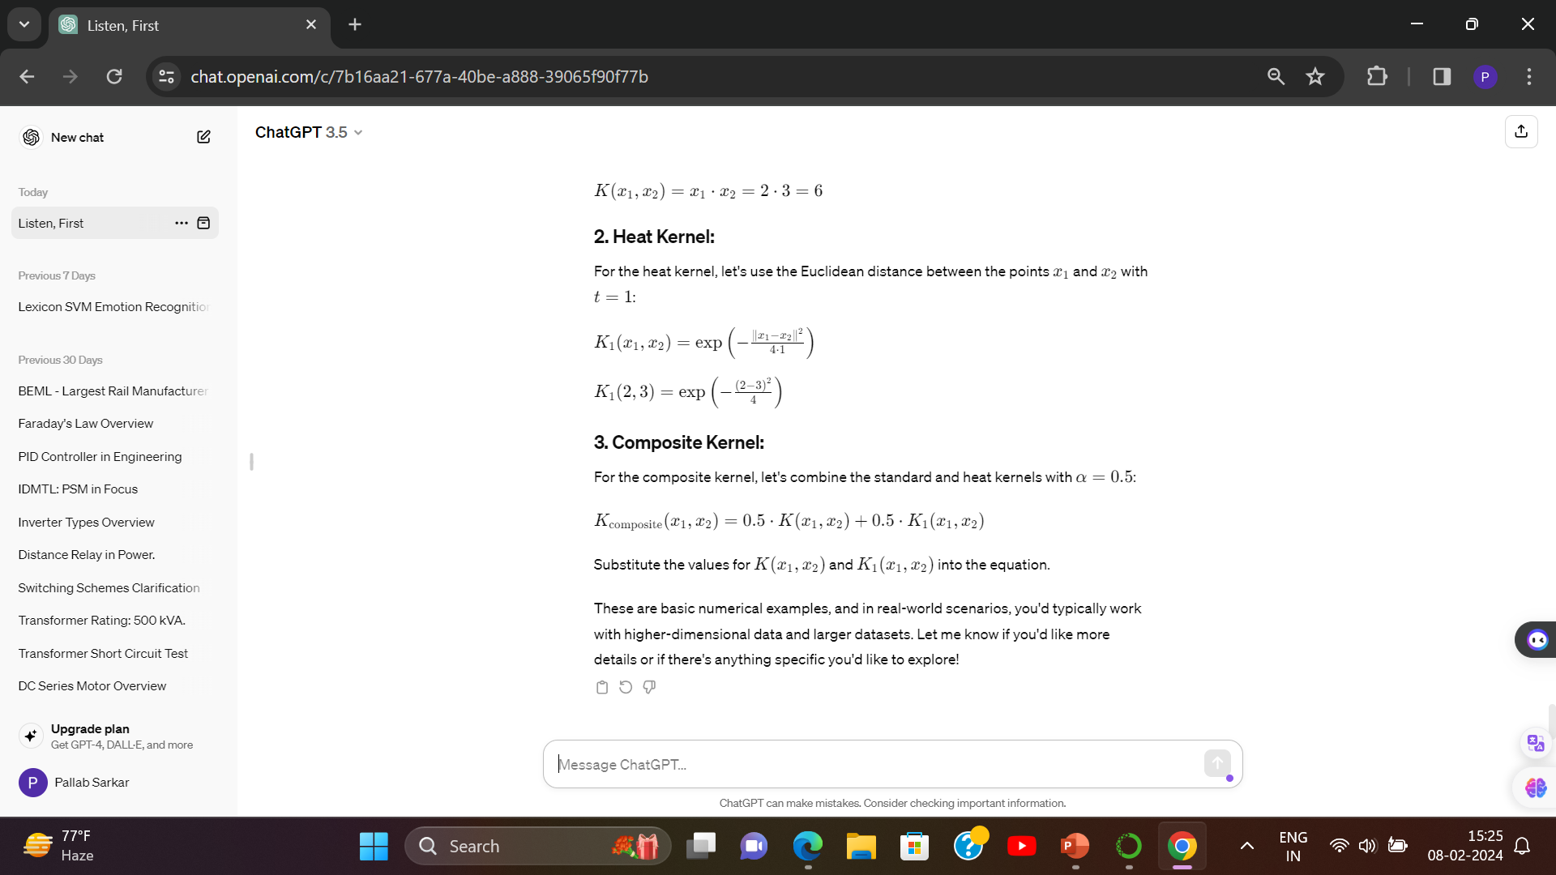


Slide 14
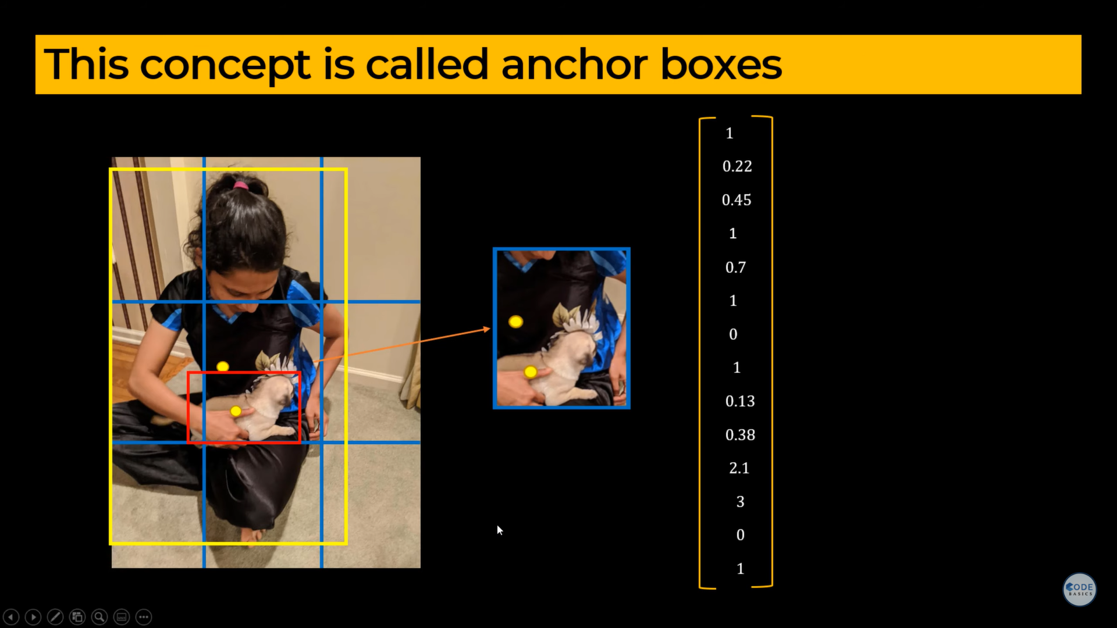
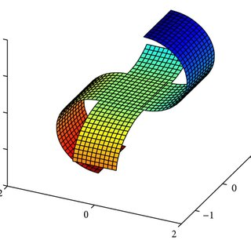
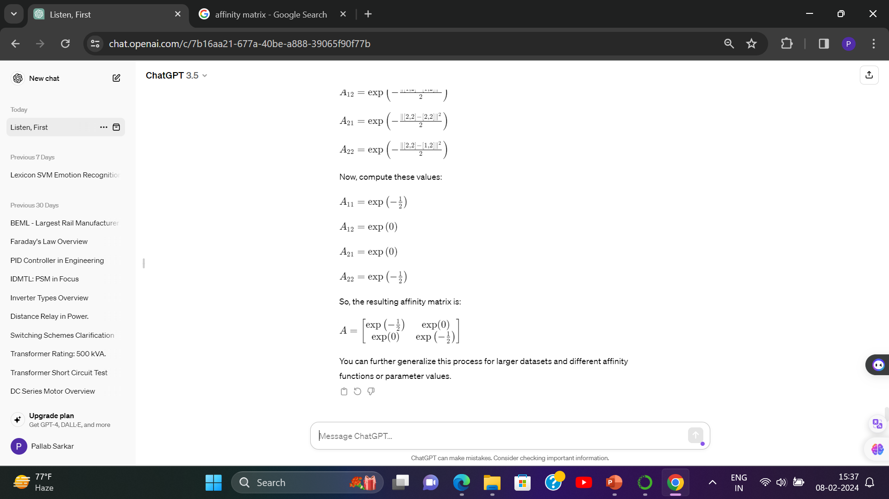
Anchor Boxing For Object Localization:
Suppose for a Non Manifold Shape (in image) , the anchor box of Localization of Both the Dog & Human in ref image has been merged & combined in the Matrix. Here in the same matrix all related Affinity Values are represented. To remove redundancy the similar multiple occurrence are deleted,
Similarly , for a Two Object manifolds that have common surface of affinity matrices are represented as anchor box .
In this image Manifold A & Manifold B are equi-plane on
(-1,1,0) axis. So they share common affinity boundaries .

Slide 15
# EXAMPLE OF GRAPH EMBEDDING + AFFINITY FUNCTIONS + Kernels- heat & composite
Imagine a messy room full of toys. We want to organize them simply - like cars together, dolls together. That's dimensionality reduction: simplifying complex data.
Now, connect the toys with strings based on how similar they are - red cars get a red string. This network of strings is a graph embedding: understanding data by studying connections.
The strings' lengths show how close friends the toys are - that's the affinity function. Heat kernels are special stretchy strings that adjust how close friends seem.
But what if we have two messy rooms with different toys? We use separate sets of strings for each - that's separate affinity matrices.
Finally, to play with all the toys together, we combine all the strings into one big map - that's a composite kernel. This is especially useful for things like maps with lots of different information layered on top.
By using these tools, we take messy data and organize it, making it easier to understand and use!

Slide 16
How this modifications performed in Manifold Learning?
Nonlinear manifold-learning methods can be global or locally based, with global methods having greater computational overhead for large data sets. Local methods may yield good results for data sets with significant local variability or submanifolds.
Popular approaches include isometric feature mapping, t-SNE, and locally linear embedding. (ISOMAP / T-SNE /LLE)
Dimensionality reduction algorithms adapt a graph embedding platform to compute the affinity matrix from which the graph Laplacian . The optimal dimensionality for the hyperspectral data set is approximately eight for classical global mani-fold-learning embeddings and 15-17 for local and iterative embeddeddings.

Slide 17
Now I describe on of these NLDR Techniques. ➔ t-SNE

Slide 18
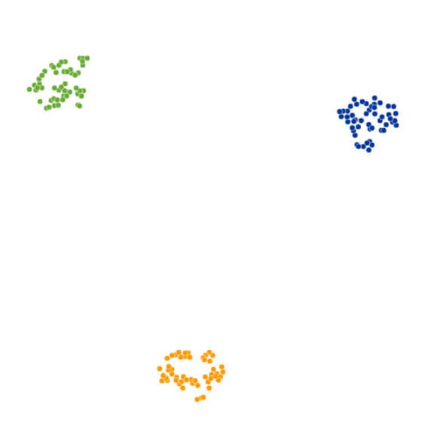
t-SNE
t-SNE (t-distributed Stochastic Neighbor Embedding) is an unsupervised non-linear dimensionality reduction technique for data exploration and visualizing high-dimensional data. Non-linear dimensionality reduction means that the algorithm allows us to separate data that cannot be separated by a straight line.
How t-SNE works
The t-SNE algorithm finds the similarity measure between pairs of instances in higher and lower dimensional space. After that, it tries to optimize two similarity measures. It does all of that in three steps.
t-SNE models a point being selected as a neighbor of another point in both higher and lower dimensions. It starts by calculating a pairwise similarity between all data points in the high-dimensional space using a Gaussian kernel. The points that are far apart have a lower probability of being picked than the points that are close together.
Then, the algorithm tries to map higher dimensional data points onto lower dimensional space while preserving the pairwise similarities.
It is achieved by minimizing the divergence between the probability distribution of the original high-dimensional and lower-dimensional. The algorithm uses gradient descent to minimize the divergence. The lower-dimensional embedding is optimized to a stable state.
The optimization process allows the creation of clusters and sub-clusters of similar data points in the lower-dimensional space that are visualized to understand the structure and relationship in the higher-dimensional data.

Slide 19
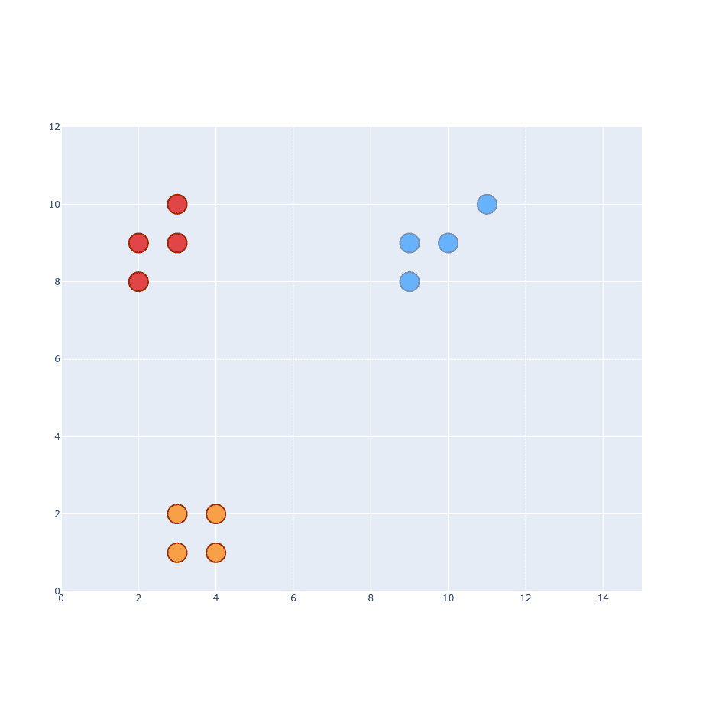
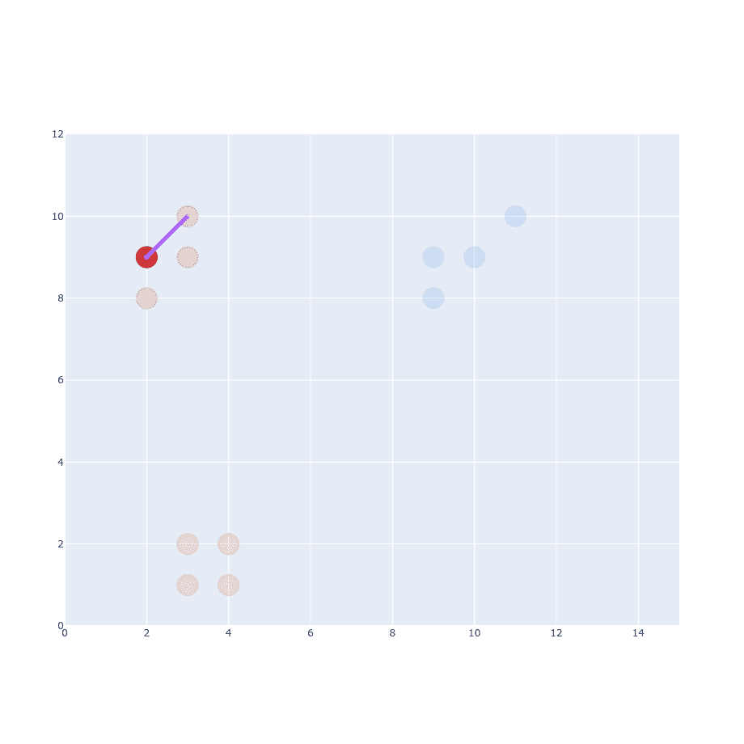
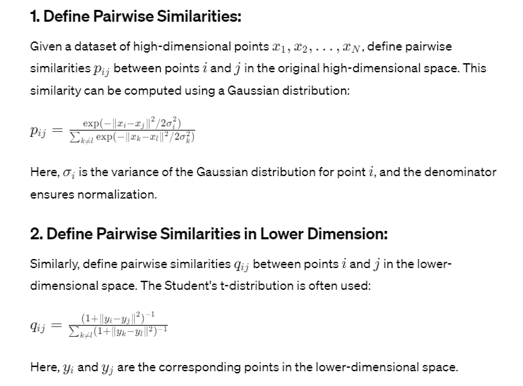
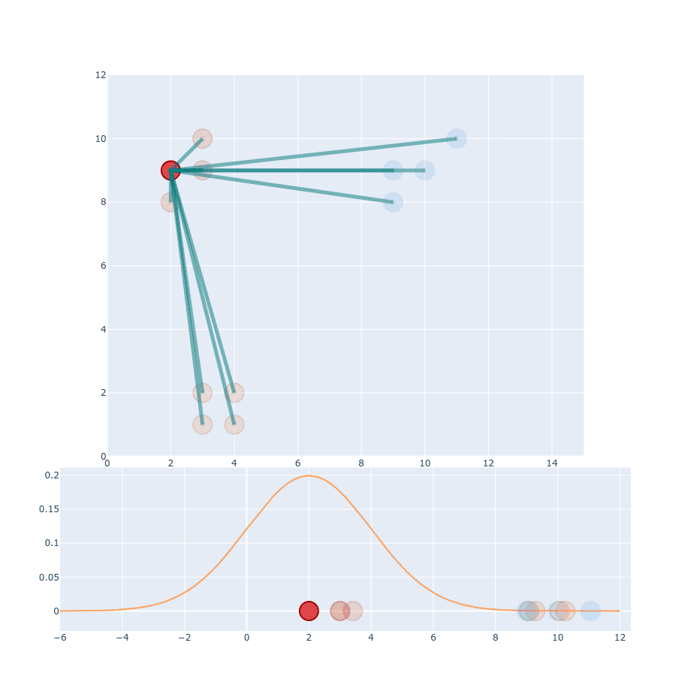
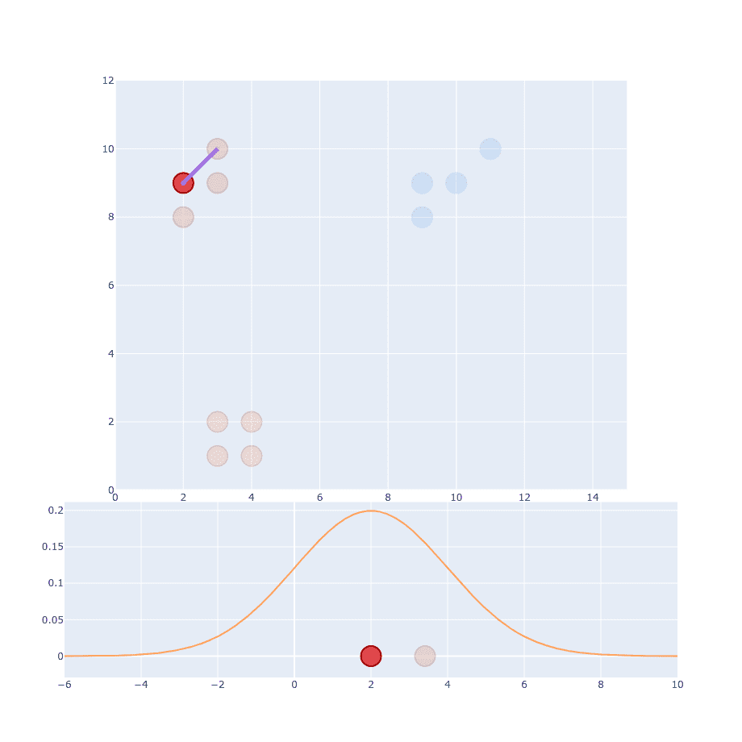
t-SNE
MATHEMATICAL DERIVATION
CASE I

Slide 20
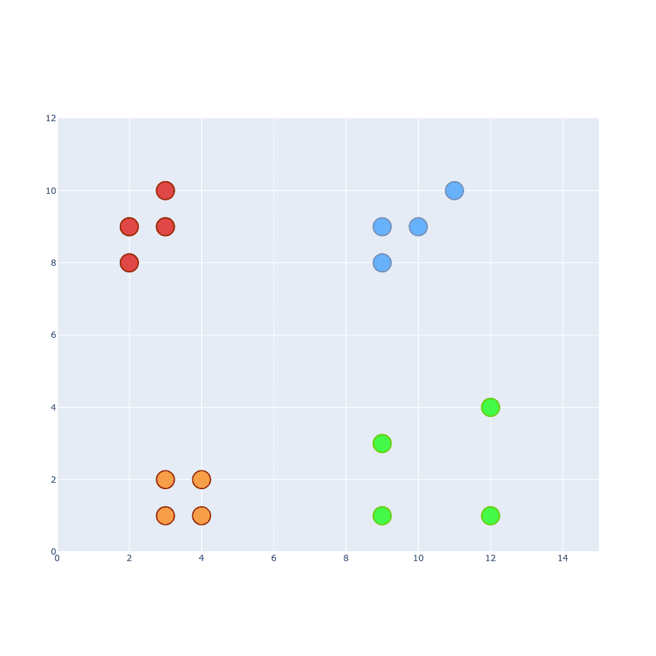
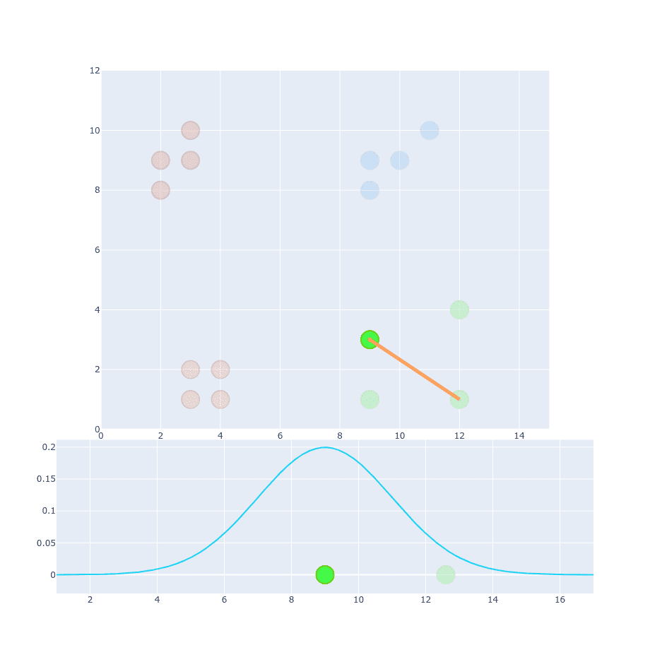
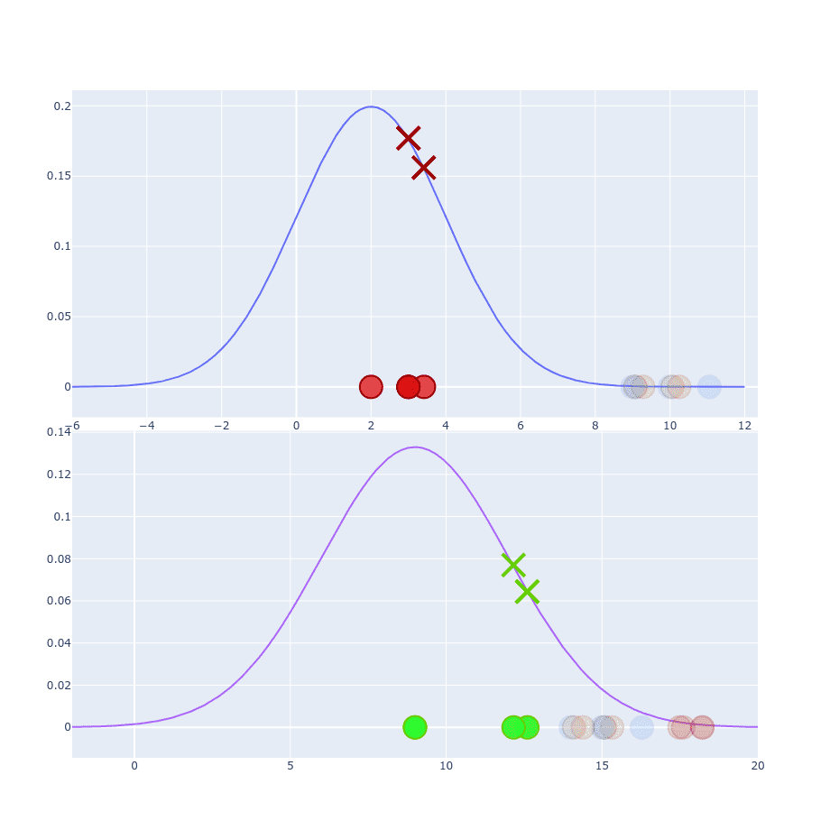
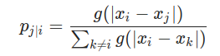
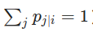
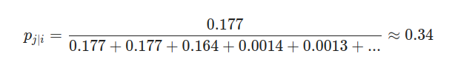
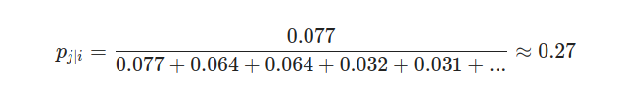
t-SNE
MATHEMATICAL DERIVATION
CASE II
We can fix that by dividing the current projection value by the sum of the projections.
Which if you apply to the first example will look Probability distribution looks like:
And for the second example:
This scales all values to have a sum equal to 1. It’s a good place to mention that p_{i|i}​ is set to be equal to 0, not 1.

Slide 21
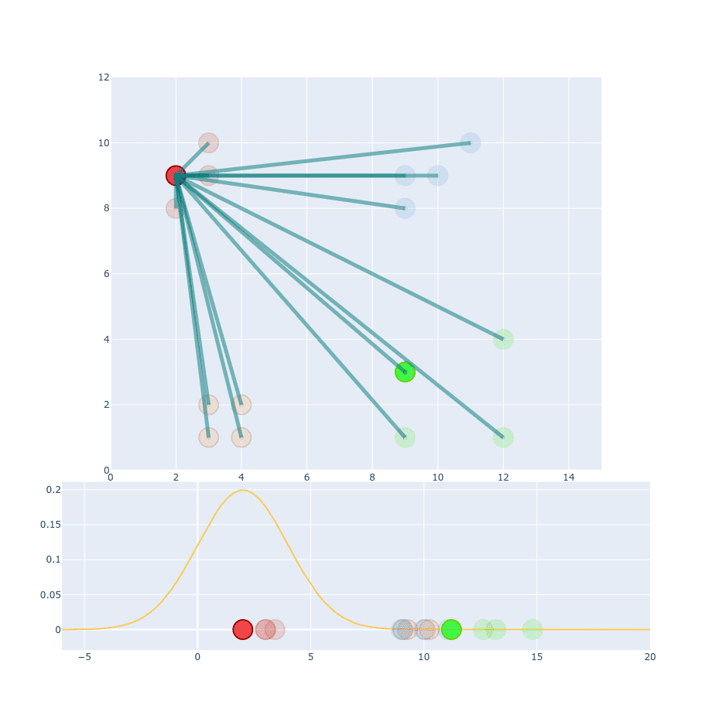
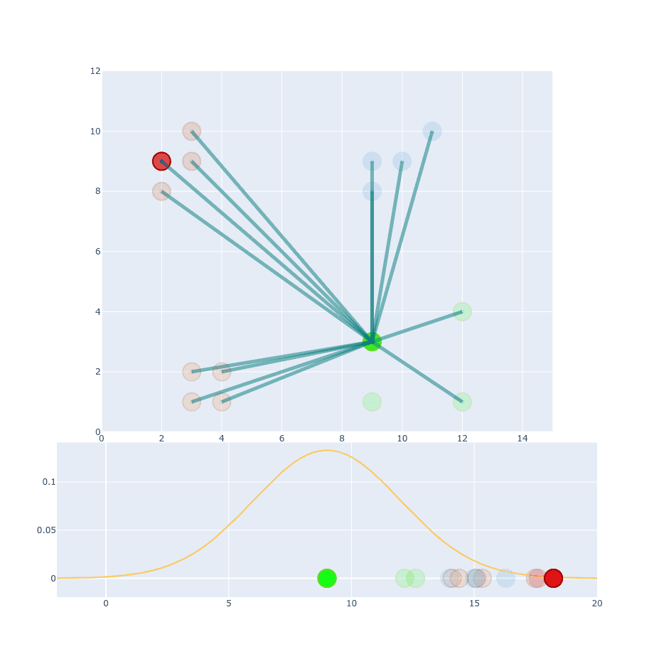
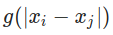
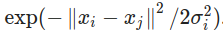
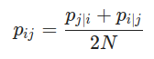
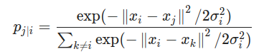

is
t-SNE
MATHEMATICAL DERIVATION
If you look at this formula. You can spot that our
=
≠
The reason for that is because they are coming from two different distributions. Which one should we pick to the calculation then?
So from Here , for N –dimensional Gaussian surface our formula will be

Slide 22
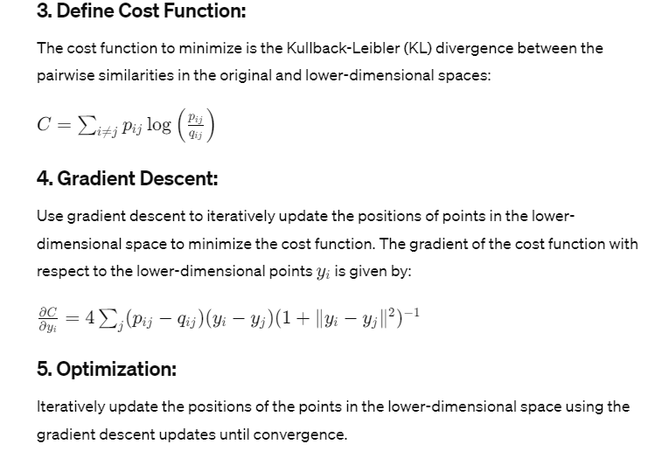
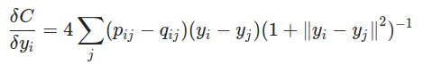
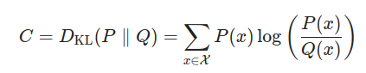
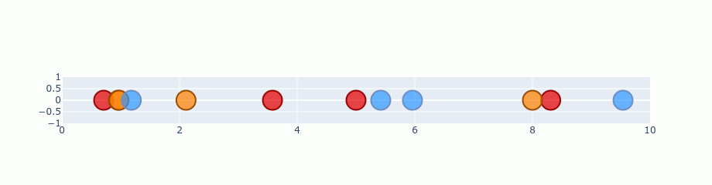
t-SNE
MATHEMATICAL DERIVATION
To optimize this distribution t-SNE is using Kullback-Leibler divergence between the conditional probabilities p_{j|i} and q_{j|i}
=
t-SNE Plot (O/p)
Early Exaggeration
Early Compression

Slide 23
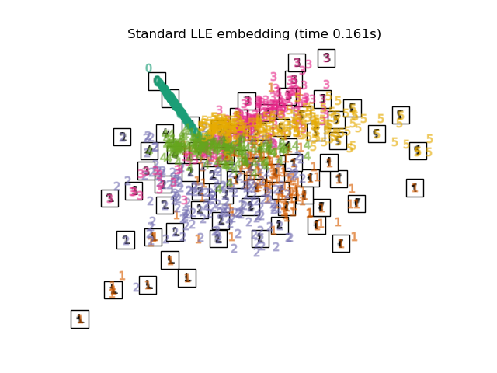
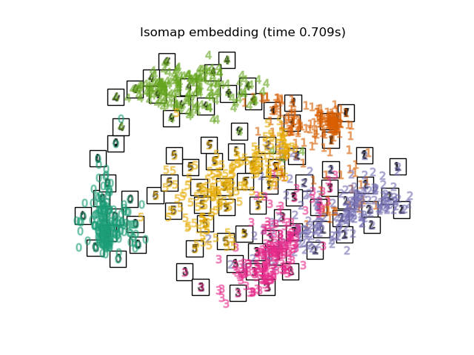
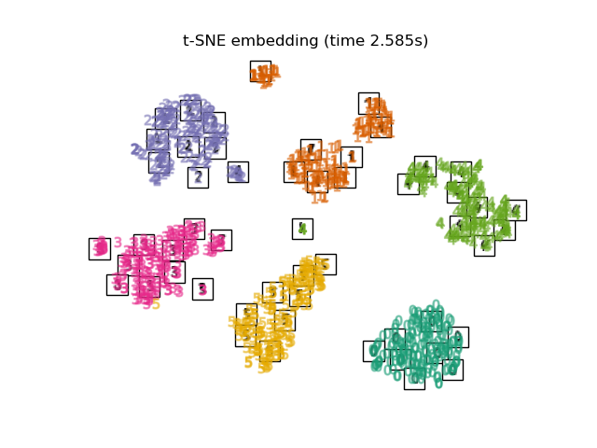
Manifold Learning Algorithms
Isomap
One of the earliest approaches to manifold learning is the Isomap algorithm, short for Isometric Mapping. Isomap can be viewed as an extension of Multi-dimensional Scaling (MDS) or Kernel PCA.
Locally Linear Embedding
Locally linear embedding (LLE) seeks a lower-dimensional projection of the data which preserves distances within local neighborhoods.
t-distributed Stochastic Neighbor Embedding (t-SNE)
t-SNE (TSNE) converts affinities of data points to probabilities. The affinities in the original space are represented by Gaussian joint probabilities and the affinities in the embedded space are represented by t-distributions.

Slide 25
NEW DIRECTIONS OF MANIFOLD LEARNING
1. Manifold Learning for MultiTemporal Image Data
Classification of remotely sensed data from multiple scenes acquired at different times or from spatially disjoint areas is an important problem.
When the goal is to exploit limited labeled data in a transfer learning mode to classify data in other scenes, changes in the manifold between images can result in misclassification of similar classes.
Recent investigations provide the foundation for a correspondence-based framework to classify hyperspectral data acquired in multiple time periods or from spatially disjoint areas.
The inter-image distances and the resulting alignment are based on bridging pairs determined from the spatial-spectral optimization.

Slide 26
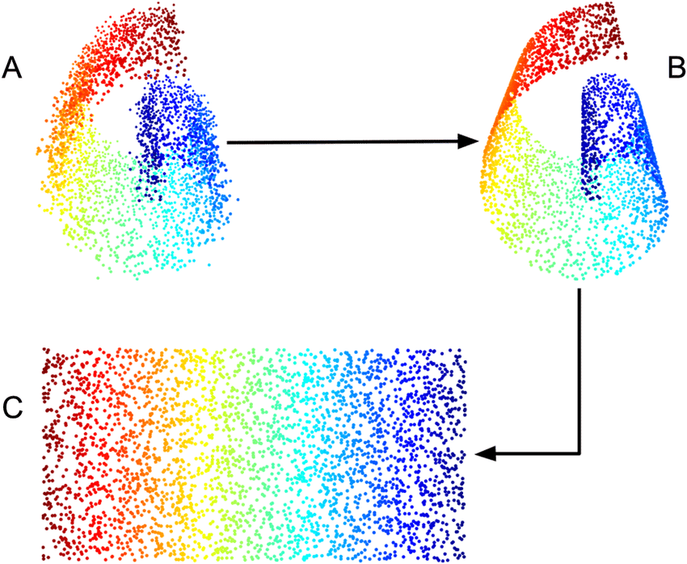
Imagine a Twisty Garden Hose:
High-dimensional data: Think of multitemporal image data as a long, multi-colored garden hose that twists and turns in a high-dimensional space. Each point on the hose represents a pixel with its own unique color values.
Finding the underlying structure: Manifold learning aims to find the essential shape or "manifold" of the hose, even though it's tangled in a higher-dimensional space. It's like flattening the hose onto a flat surface while preserving its twists and curves.
Steps for Manifold Learning:
Gather the Image Data: Collect images of the same area taken at different times (multitemporal).
Represent as Points: Represent each pixel in the images as a point in a high-dimensional space, where each dimension corresponds to a color value or other feature.
Measure Similarities: Calculate how similar or close different pixels are to each other based on their features.
Discover the Manifold: Use algorithms like Isomap, LLE, or t-SNE to find the low-dimensional structure (the manifold) that captures these similarities. Visualize this manifold as a 2D or 3D representation.

Slide 27
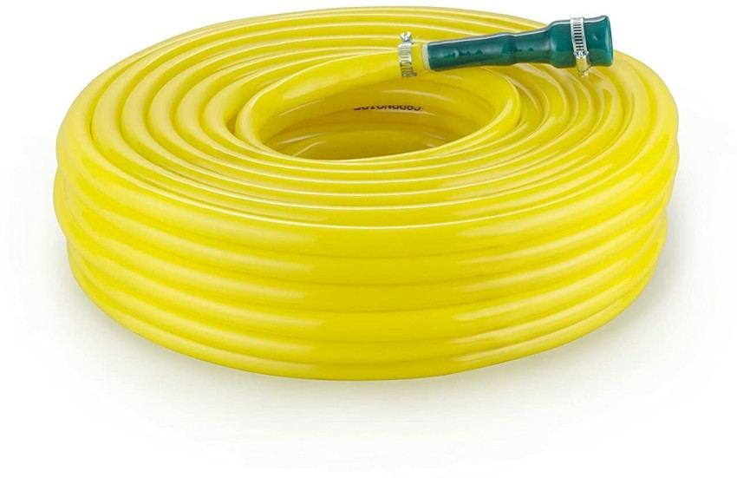
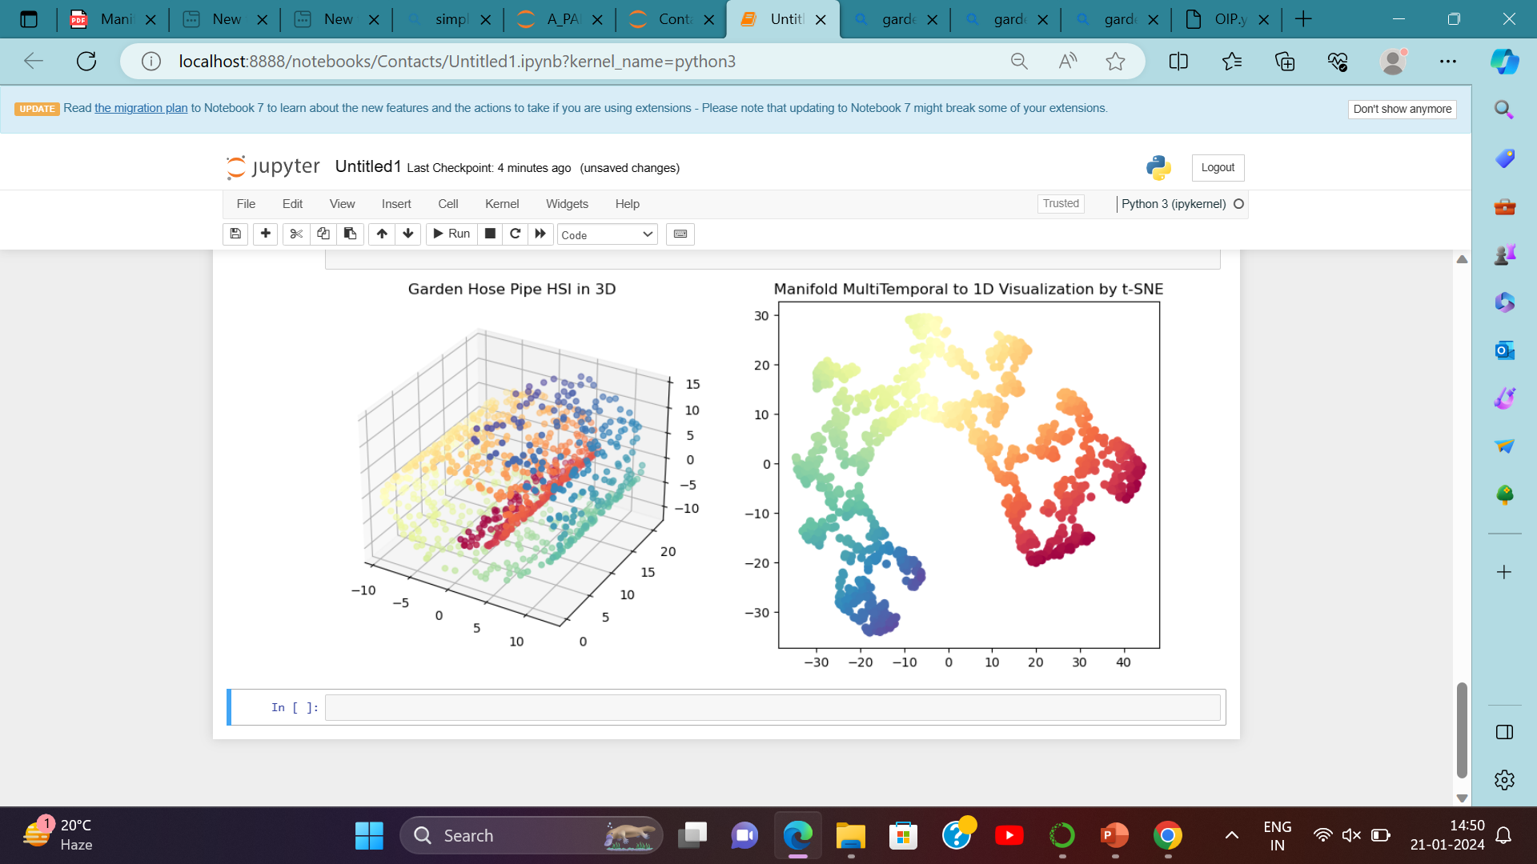
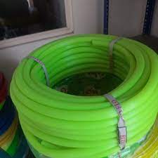

Slide 28
2.Locality Preserving Discriminative Dimensionality Reduction (LPDDR)
PCA, LDA, and their variants are commonly used for feature extraction prior to classification of hyperspectral data.
LPDDR seeks to find a linear map that preserves the local neighborhood structure of the data in the projected subspace.
LPDDR obtains good between-class separation in the projection while preserving the within-class local structure.

Slide 29
An example of Locality Preserving Discriminative Dimensionality Reduction (LPP) could involve a dataset of handwritten digits, such as the famous MNIST dataset.
In this example, LPP could be used to reduce the dimensionality of the dataset while preserving the local structure and discriminative information.
Let's say we have a set of handwritten digit images, each labeled with the corresponding digit (0-9). LPP could be applied to this dataset to find a lower-dimensional representation that maintains the local relationships between the digits while emphasizing the differences between them. The result would be a reduced representation of the digits that captures their essential characteristics in a lower-dimensional space.
This lower-dimensional representation could then be used for tasks such as classification or visualization, where the goal is to accurately distinguish between different digits while reducing the complexity of the data.

Slide 30
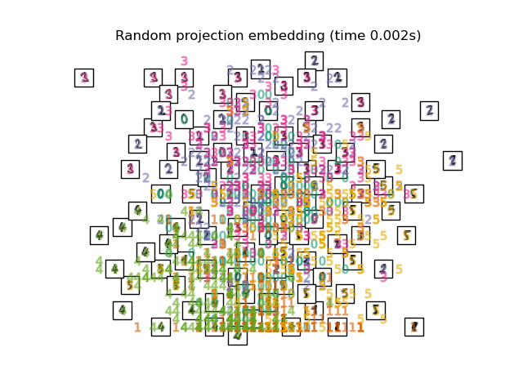



Example – MNIST Handwritten Digit Dataset ( tensorFlow)

Slide 31



3.Manifold Learning for Spatial-Spectral Classification of HSI

Slide 32
4. Stochastic Neighbour Embedding On Spherical manifolds
Stochastic embedding on spherical manifolds is a technique for visualizing high-dimensional data that lies on a spherical surface or manifold. Here's a brief overview:
1. It's used to map high-dimensional spherical data onto a lower-dimensional space while preserving the spherical structure.
2. This technique uses probabilities to represent similarities between data points, aiming to maintain the local relationships on the spherical surface.
3. Stochastic embedding on spherical manifolds is helpful for understanding and visualizing data that naturally exists on a spherical structure, such as geographic data or 3D spatial data.
4. By employing this method, it becomes easier to explore and interpret complex spherical datasets.

Slide 33
EXAMPLE –Protein(Amino Acid Spherical Conformation)
Use Case: Analyzing Protein Conformations
Consider a scenario where you have a dataset representing different conformations of a protein. Each conformation can be characterized by a set of features, and the goal is to visualize these conformations in a lower-dimensional space for better understanding and analysis. Since proteins often have complex, three-dimensional structures, including spherical aspects, t-SNE can be useful.
Steps:
Data Representation:
Each protein conformation is represented as a high-dimensional vector based on its structural features.
High-Dimensional to Lower-Dimensional Mapping:
Apply t-SNE to map the high-dimensional protein conformations into a lower-dimensional space, such as 2D or 3D.
Visualization:
Visualize the mapped conformations in the lower-dimensional space.
Colors or labels can be used to represent different classes or states of the protein (e.g., active vs. inactive states).
Analysis:
Examine the spatial relationships between protein conformations in the lower-dimensional space.
Identify clusters of similar conformations, which may correspond to specific structural motifs or functional states.
Insights:
Gain insights into the structural dynamics and relationships between different protein conformations.
Understand how certain structural features contribute to the overall conformational space.

Slide 34








Aminoglycoside phosphotransferase- CONFORMATION
4DBX
4DE4

Slide 35



Slide 36


Structure exists: 'C:\Users\usark\Contacts\db\pdb4dbx.ent' Structure exists: 'C:\Users\usark\Contacts\de\pdb4de4.ent’
Accuracy with PCA: 89.33% Confusion Matrix: [[ 48 11] [ 8 111]]
Classification Performance

Slide 37


Accuracy with LocallyLinearEmbedding: 84.83%
Confusion Matrix: [[ 43 16] [ 11 108]]

Slide 38


Accuracy with Isomap: 90.45% Confusion Matrix: [[ 50 9] [ 8 111]]

Slide 39
CONCLUSION
Manifold-learning techniques can be used to classify remotely sensed data on nonlinear manifolds, but limitations and opportunities remain for research and applications.
Nonlinear methods require parameter tuning and have higher computational overhead. Manifold learning is data-driven and results are dependent on the characteristics of the data.
Developing appropriate characterizations for submanifolds is an open research problem, and hierarchical manifold structures appear to have merit. Research is needed for feature extraction from single images and joint exploitation of global and local embedding methods in dynamic environments.

Slide 40
Reference
Towards Data Science – www.tdds.org/i/manifold_learning
V.N. Thomas Albey
( Research Paper on Kenndey Space Centre)
3. OpenAI Bootcamp Resources
repository.openai.com/bootcamp/2018125/pdf4
4. Joblin Jackie – University of Washington
www.uwag.gov.usa/i/97128ii_761
5. Personal Documentation
ds_Pallab.sourceforage.com/hsi_image_

